Slide 1
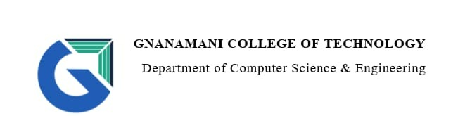
A Way of Securing data
by
Badhrinathan.N
Manikandan.G

Slide 2

Overview of presentation
01.$whoami
02.Introduction to Cyber Securiy
03.Needs of Cyber security
04.Types of Security
05.Cyber Crime
06.Types of cyber attacks
07.Securing our personal information

Slide 3
Introduction to cyber security
Cyber Security is the way of protecting a system or sensitive data about an user from Hacker
It can be divided into two parts one is cyber and another is security. Cyber refers to the Technology that includes systems, networks, programs and data And security is Concerned with protection of systems, networks, application, and Information.

Slide 4
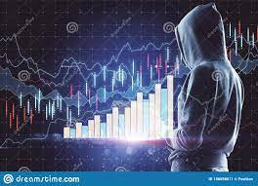
Needs of Cyber Security
Technology has some good side and bad side We all know Technology made our life easier to complete our day to day task
The Dark side of Technology is….
Whenever technologies are increasing daily The Company doesn’t give 100% assurance to your data. Because of raising cyber threats and Cyber attacks
That why much needed Cyber security is needed to protect the data.

Slide 5
Cyber attacks faced by India
Malware attack on Kudankulam Nuclear Power Plant
Tamil nadu Farmers family card data leak
TNPDS
!
2018
2020
2022
2019
2021
Cosmos Bank Cyber Attack in pune
Your Text
.Aadhar data leak
UIADI
Example Text :
Get a modern PowerPoint Presentation that is beautifully designed.

Slide 6
Types of Security
Network Security
Cloud Security
.
It is a collection of security measures designed to protect cloud-based infrastructure, applications.
IOT Security
Malware protection
Internet of Things, refers to the collective network of connected devices and the technology that facilitates communication between devices and the cloud.
Application Security
Network Security
Cloud Security
Involves access control, virus and antivirus software, application security, network analytics, types of network-related security
Application Security
Include authentication, authorization, encryption, logging, and application security testing. Developers can also code applications to reduce security vulnerabilities..
IOT security
Malware Protection
It is cyber Security Solution it adds security layer. to the system and keeps virus free

Slide 7

Network
Security
Involves access control, virus and antivirus software, application security, network analytics, types of network-related security
Network Security works to keep the network safe from cyber attacks, Hacking attempts, and employee negliance
Blocks the unwanted request from the client side

Slide 8
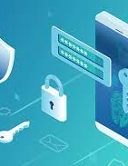
Application
Security
Include authentication, authorization, encryption, logging, and application security testing. Developers can also code applications to reduce security vulnerabilities
Application Security is the process of developing or adding and testing security features with in application to prevent security Vulnerblities against threats such as Unauthorized access of modification
The Application Security is solving their bugs, Vulnerbality in an application and provide an Updated version

Slide 9
Malware
Protection
It is cyber Security Solution it adds security layer. to the system and keeps virus free
It works as a entry controlled by checking device when the connected device has a malware means, It notify the user and also vomit the infected device
Be aware with Malware

Slide 10
Cloud security &IOT Security
These are Growing Technologies The Cloud Security refers to a collection of Security measures designed
to protect cloud – based Infrastructure , application and
data
The collective network of connected devices and the technology that facilitates communication between devices and the cloud.
A Way of protecting cloud based Infrastructure

Slide 11
Cyber Crime
White collar crime
Cyber Crime is an Intellectual crime. It considered as a White collar crime Those who commits such crimes manipulate the computer system in intelligent manner
Day by day technology is playing a major role in a person’s life the cyber crime also will along with technical advances

Slide 12

Cyber attacks targets user!
Digital Piracy
Ransomware
Digital piracy is about the copyright violation of software created originally by an Individual or an Company.
Ransomware is malicious program that can perform varity of functions Including Stealing Encrypting data or deleting it it also hijack the victims system .
Phishing
This kind of attacks is target an particular user by creating fake website like as a real website and The attacker Encourages the user to enter login credits.
Online Financial Transaction
Cyber-stalking
It defines that the hacker can steal money over the internet
It also Includes Banking Fraud, Computer Manipulation Accounting Scams
Social media crime
Cyber Criminals use Social media website to identify victim and steal their personal information.
Identity Theft
It is a crime Where The Criminals Impersonate Individuals usually for financial gain
.

Slide 13

Vulnerablity
A weakness in a Application that lets hackers get into a computer network
The Cyber Criminal Takes Advantage with vulnerable application
This is server side problem if any Bad instance occurs to thier user.The Company only full Responsible for that

Slide 14

Overcome Vulnerablity
We can’t overcome Vulnerablity Fully….
But Taking Some Security measures is to reduce Vulnerable
The company should Read Bugs report from Penetration tester

Slide 15
Computer Ethics
1. Honesty: Users should be truthful while using the internet.
2. Confidentiality: Users should not share any important information with unauthorized people.
3. Respect: Each user should respect the privacy of other users
4. Professionalism: Each user should maintain professional conduct.
5. Obey The Law: Users should strictly obey the cyber law in computer usage.
6. Responsibility: Each user should take ownership and responsibility for their actions

Slide 16
Securing our Personal Information
Avoid Sharing Person Information on Social Medias like sharing their DOB, pet name, Boy Friend name, Girl Friend name
Avoid using pet name, DOB as password
Avoid Sharing passwords and avoid using same password on different website
Don’t spread Spam messages over the internet
.

Slide 17
Conclusion
“Our data is also our Valuable property too!”
Don’t Underestimate Your Data

Slide 18
THANK YOU

Slide 19
THANK YOU

